Slide 1
Ideology, Court Support and Judicial Legitimacy in Canada
Andrea Lawlor
Associate Professor
McMaster University
Erin Crandall
Associate Professor
Acadia University
February 8, 2025

Slide 2
Confidence in Canada’s Courts
Please indicate how much confidence you have in the Canadian courts (2000, 2004, 2008 asks “the SCC”)
Source: Canada Election Studies (1997-2021), Judicial Legitimacy Survey (2023)

Slide 3
Confidence in Canada’s Courts
Please indicate how much confidence you have in the Canadian courts (2000, 2004, 2008 asks “the SCC”)
Source: Canada Election Studies (2008-2021), Judicial Legitimacy Survey (2023)

Slide 4
Confidence in Judicial Institutions
Court Support
Support for the institution of the court
Court Curbing
Support for restraining court power
Rule of Law
The non-arbitrary application of law
Notes:
We’re interested in looking at these three phenomena by what we believe are two useful predictive factors: 1. political / partisan positioning and 2. subjective ideological agreement with the courts – which refers to how an individual perceived their own political commitments vis a vis another institution – in this case the courts.
We don’t present it here, but we’ve also looked at other patterns in the data – e.g. whether there are notable findings by gender, education levels, knowledge of the courts, experience with the courts. And these do yield some interesting findings, but for the sake of time, I’ll limit my discussion to partisanship and SIA. Happy to talk about the others in the Q&A

Slide 5
Court Support
Source: Judicial Legitimacy Survey (2023)
Notes:
Top line numbers
36% of respondents think the SCC is “too political”; nearly 40% think it favours some groups over others (note we don’t ask what groups, so for some it could be corporate interests, and for others it could be groups within society); but there is a solid majority who think that they can usually be trusted to make decisions in the best interest of Canadians
Results are a bit mixed, and I’d also point to the proportion of people who answered neither (form of non- response)
Generally, this speaks to some level of confidence and perhaps an absence of routine engagement with these issues which we would suspect

Slide 6
Court Curbing
Source: Judicial Legitimacy Survey (2023)
Notes:
Court curbing refers to the propensity for someone to support measures to control the court’s authority. There’s a vast literature, as well as examples of attempts to do this in the US (court packing, etc). Some could be legitimate policy measures (rethinking term limits or retirement dates) but when it has a political dimension rather than an institutional strengthening motive, it can be problematic.
The data here come from our 2023 survey. These aren’t just standalone questions we ask out of the blue. The first two have a bit of a vignette that goes with them that I don’t include on the slide for reasons of length, but in short, the first presents the respondent with a scenario that is balanced between two perspectives. I gets to the idea that Canadians don’t think of these ideas in a vacuum, but really only think about their views on the courts in a handful of a scenarios, the most likely of which is a media report.
What’s interesting here:
The first two questions are purposefully set up to gauge Cdns opinions not just toward the courts, but the separation of powers. They each position the legislature/government against the courts to see where citizens fall.
Nearly half support the idea that judges’ salaries should be set by government. As we all know this flied in the face of jurisprudence and probably reflects the fact that much of the public is not familiar with the 1997 Reference on Remuneration. However, a solid majority also supports limiting judges’ tenure
Similarly, the full question for #3 asks If the Supreme Court started making a lot of rulings that most Canadians disagreed with, it might be better to reduce the powers of the Court to decide certain types of controversial issues” and nearly half of Canadians agree with this, which reflects the thought that the court should be a majoritarian institution, inconsistent with most notions of the separation of powers
In Canada, pay raises for judges are reviewed by independent commissions who make recommendations to government. The [Conservative/no specification] government recently rejected the recommendation of the commission and decided instead that judges will not receive a raise. While the government has stated that its decision is based on its promise to balance the budget, it has also lost several high-profile and controversial court cases. Do you agree that the government should be able to control the salaries of judges?
In the face of unpopular decisions by the Supreme Court, the Prime Minister has proposed to cut the length of time Supreme Court justices can serve from the age of 75 to a limit of 10 years. The Canadian Bar Association is critical of this decision, stating that it weakens judicial independence, but the Prime Minister has responded that this is a way to make judges more accountable for their decisions. How strongly do you support/oppose this proposal?

Slide 7
Rule of Law
Source: Judicial Legitimacy Survey (2023)
Notes:
This is the first time we’ve presented this data and to my knowledge, it’s the first time this type of data has been gathered in Canada. Here we’ve adapted metrics from the US literature on the Rule of Law (Alex Badas’ work) so this battery of questions is not our own invention, it’s an independently tested set of measures that capture a validated underlying phenomenon.
Of course, it’s also a set of measures from the US so the purpose of us testing them here is to see how valid a set they are in the Canadian context. While the audience here may have a much more sophisticated idea of the concept of RoL, this is a useful set of measures that engages public views toward law and government authority. It’s not the full set of measures, but there are some useful findings.
A very clear majority reject the notion that one can obey a law that is unjust or that law in somehow “unimportant”
Closer to half, though, think there may be some wiggle room in the law to deal with pressing problems (e.g. tariffs) and there seems to be some sympathy for the idea of solving problems “immediately”

Slide 8
Court Support by Party
The Supreme Court of Canada is too political
The Court favours some groups over others
The Court can usually be trusted to make decisions that are in the best interest of the Canadian people
10%
20%
30%
40%
50%
60%
70%
80%
% Agree
Notes:
There hasn’t been a ton of work on public opinion toward the courts in Canada’s history. A great article from 2004 that sets this work up very well, and some limited polling by Angus Reid and others
In terms of explanatory factors, there hasn’t historically been a lot of evidence that partisanship has mattered to public opinion toward the courts, but the Angus Reid data and some work we published based out of a separate survey in 2021 suggests that is changing.
First, we can see clear patterns around partisanship here. Conservatives stand apart from their partisan counterparts on all measures. This could be a product of specific decisions, the nature of the institution, elite cues or a combination of all.
Second Liberals, perhaps as the “party of the Charter” have the most favourable views toward the courts on all indicators, sometimes as far as 25 percentage points from their CPC counterparts.
Unsurprisingly, the NDP are closer to the Liberals and Greens, and the Bloc varies a bit. We don’t show this data here, but we also ask a question about the support for use of the NWSC and Bloc partisans show strong support.

Slide 9
Court Curbing by Party
Government should be able to control the salaries of judges
The length of time SCC justices can serve should be changed from retirement at age 75 to a limit of 10 yrs
If the SCC started making a lot of rulings that most Canadians disagreed with, it might be better to reduce the powers of the Court to decide certain types of controversial issues
10%
20%
30%
40%
50%
60%
70%
80%
% Agree
Notes:
On court curbing, that gap closes a bit. There are still some partisan trends that emerge, but they are not so distinct, and they don’t necessarily follow the same pattern.
Conservative partisans are more likely to support the government controlling the salaries of judges and restraining the court’s decision-making authority, but they are – interestingly – quite against judicial term limits.
There is not a lot in terms of partisan trends here, but it’s interesting to note the Bloc’s support for term limits, which may be a reflection of dissatisfaction with decisions, but that’s speculation.

Slide 10
Rule of Law by Party
It is not necessary to obey a law you consider unjust
It might be better to ignore the law and solve problems immediately rather than wait for a legal solution
The government should have some ability to bend the law to solve pressing social and political problems
When it comes right down to it, law is not all that important. What is important is that our government solves society’s problems and make us all better off
10%
20%
30%
40%
50%
60%
70%
80%
% Agree
Notes:
On the rule of law, very few partisan trends. Canadians seem to be fairly consistent in their views here, notwithstanding their partisan preferences. Though I do find it fascinating that Liberal supporters come out several percentage points ahead of their partisan counterparts on the “solve problems immediately” and solving pressing problems.

Slide 11
Court Support by Subjective Ideological Agreement
The Supreme Court of Canada is too political
The Court favours some groups over others
The Court can usually be trusted to make decisions that are in the best interest of the Canadian people
10%
20%
30%
40%
50%
60%
70%
80%
Disagreement
% Agree
Tacit Agreement
Agreement
Notes:
Last set, subjective political agreement so this is how you view your political position vis a vis the courts. Someone who is subjective political agreement would see themselves and the court in the same position on an ideological scale (here, we keep it simple for respondents and just leave it as “progressive”, “moderate” or “conservative”).
Note: we don’t care about the actual ideological positioning of the Court or individual judges – just their topline assessment of their own position and the Supreme Courts’. Here, we see some stark trends.
1. Those in SPD

Slide 12
Court Curbing by Subjective Ideological Agreement
Government should be able to control the salaries of judges
The length of time SCC justices can serve should be changed from retirement at age 75 to a limit of 10 yrs
If the SCC started making a lot of rulings that most Canadians disagreed with, it might be better to reduce the powers of the Court to decide certain types of controversial issues
10%
20%
30%
40%
50%
60%
70%
80%
% Agree
Disagreement
Tacit Agreement
Agreement

Slide 13
Rule of Law by Subjective Ideological Agreement
It is not necessary to obey a law you consider unjust
It might be better to ignore the law and solve problems immediately rather than wait for a legal solution
The government should have some ability to bend the law to solve pressing social and political problems
When it comes right down to it, law is not all that important. What is important is that our government solves society’s problems and make us all better off
10%
20%
30%
40%
50%
60%
70%
80%
Disagreement
% Agree
Tacit Agreement
Agreement

Slide 14
Thank you
Andrea Lawlor & Erin Crandall
andrea.lawlor@mcmaster.ca / erin.crandall@acadiau.ca
This work is supported by SSHRC Insight Grant: 430-2021-00746

Slide 15
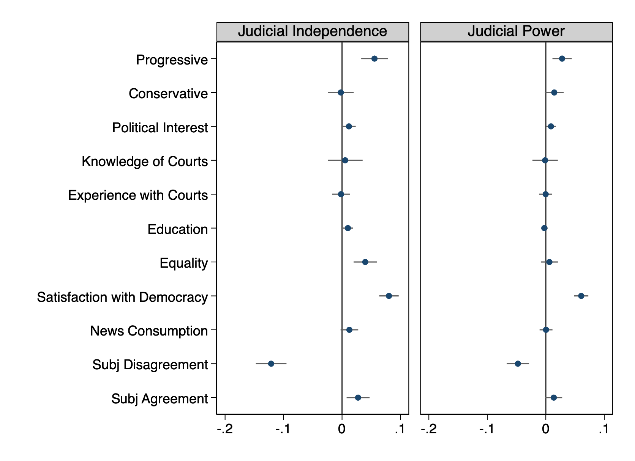
Results
Conservative are less likely than progressives (but not moderates) to display supportive attitudes toward JL
Those who ideologically disagree with the courts are less likely to display supportive attitudes toward JL

Slide 16
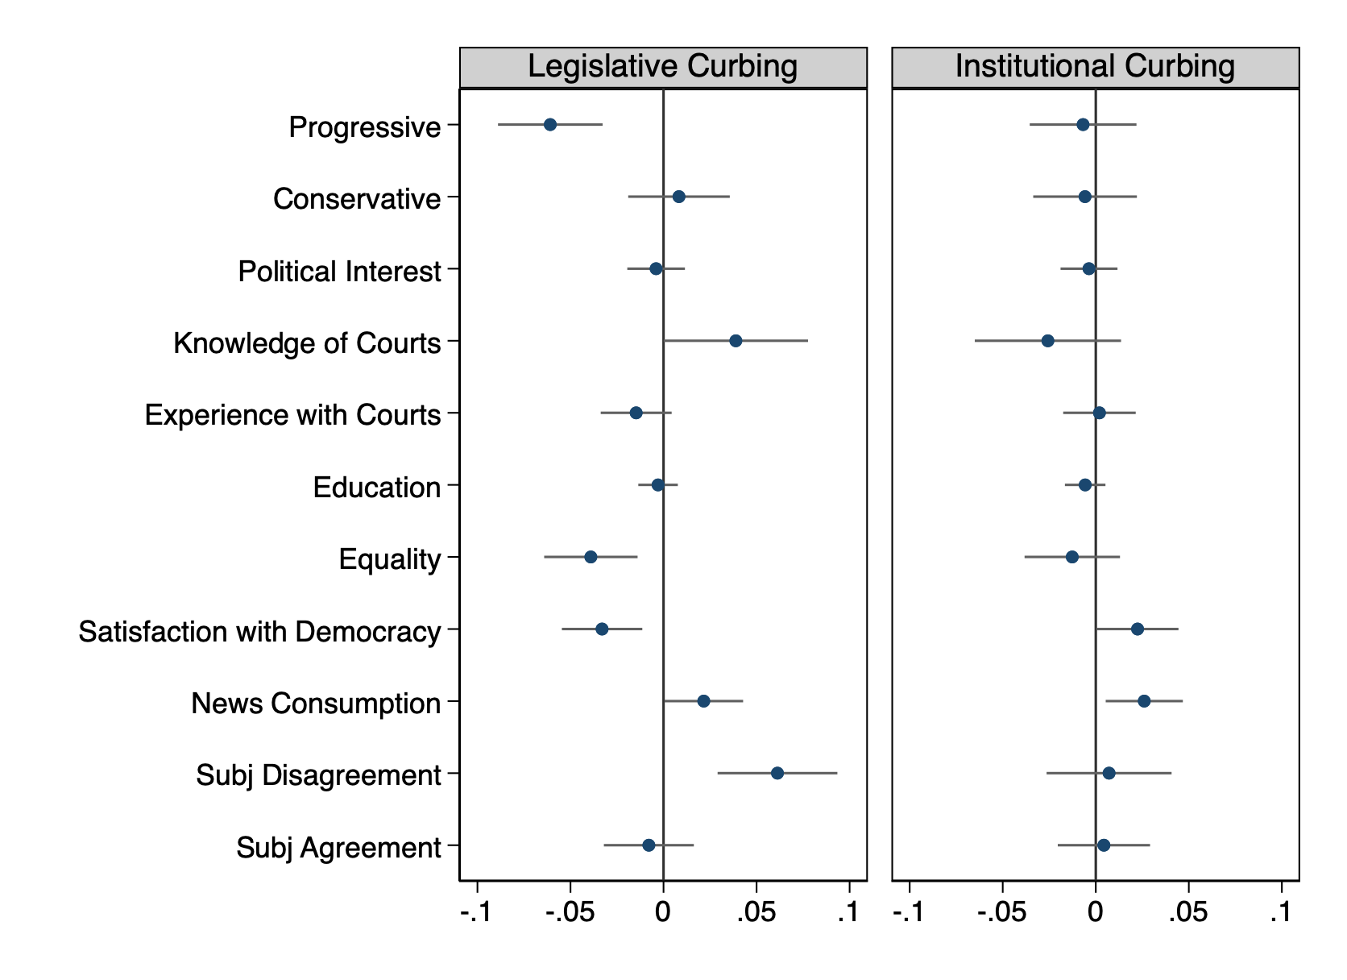
Results
Progressives are less likely than moderates / conservatives to legislatively curb the court
Those in ideological disagreement are more likely to want to leg curb the court
No one is willing to engage in institutional court curbing

Slide 17
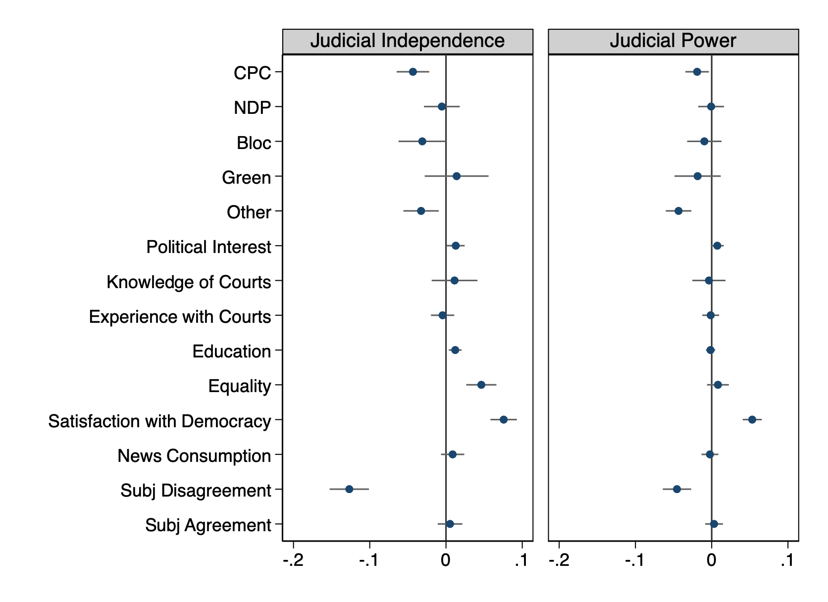
Results by Party
Compared with Liberal partisans, Conservative partisans are less likely to supportive attitudes toward JL

Slide 18
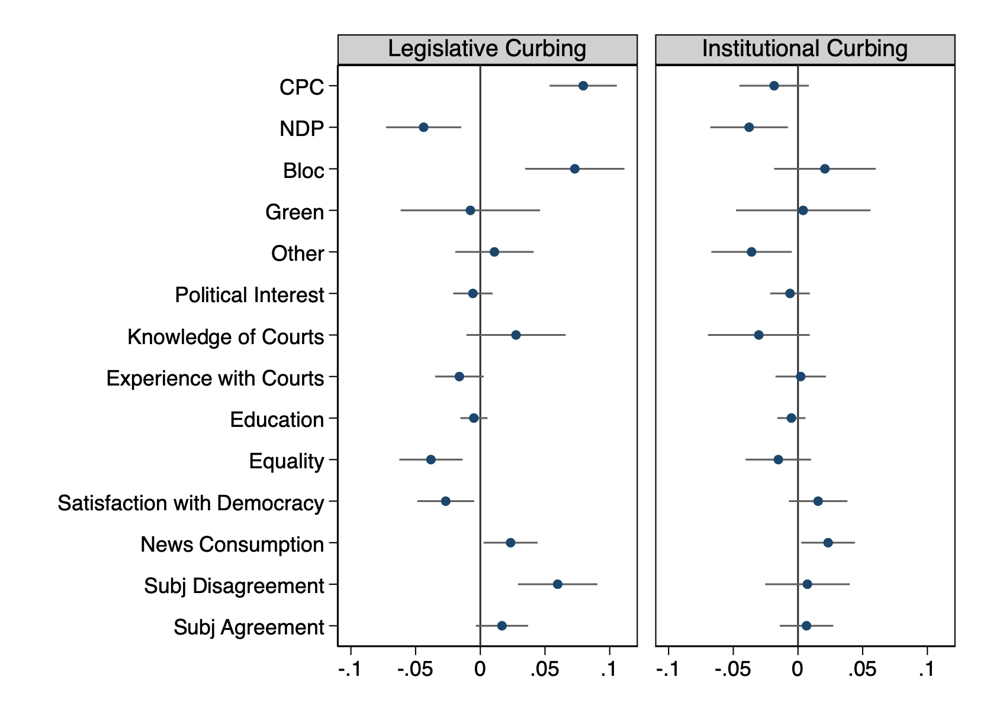
Results by Party
Compared with Liberal partisans, Conservative and Bloc partisans are much more likely to support legislative curbing
No partisans are willing to engage in institutional court curbing

Slide 19
Confidence in Judicial Institutions
Only 1 in 4 Americans trust the Supreme Court “a great deal”
(Gallup 2022)
Fewer than half of Canadians have confidence in the Supreme Court
(Angus Reid 2022)
Notes:
https://angusreid.org/canada-crime-rcmp-supreme-court-confidence/

