Slide 1
Prorogation: Historical Context
Dave Snow
Runnymede Society Law & Freedom Conference
February 8, 2025

Slide 2
What is Prorogation?
Terminates a parliamentary session, puts an end to parliamentary business
Government bills die on the order paper
Committees “cease to exist” and are reconstituted in the next session
Proclaimed by Governor General, but made on advice of PM
In practice, advice is always taken
Throne speech marks beginning of a new session
https://www.constitutionalstudies.ca/2017/09/governor-general-of-canada-the-role-the-myth-the-legend/
https://www.ourcommons.ca/procedure/procedure-and-practice-3/ch_08_6-e.html

Slide 3
Stats on Prorogations
Since 1984 election, 13 total prorogations across the 12 Parliaments
Harper and Chretien: 4 each
Mulroney: 3 times
Trudeau: 2 times
Mostly routine, until 2008
Since 2008: spike in media interest in every prorogation
https://thehub.ca/2024/12/02/dave-snow-will-justin-trudeau-prorogue-parliament-in-the-new-year-history-shows-theres-little-political-cost-to-the-practice/

Slide 4
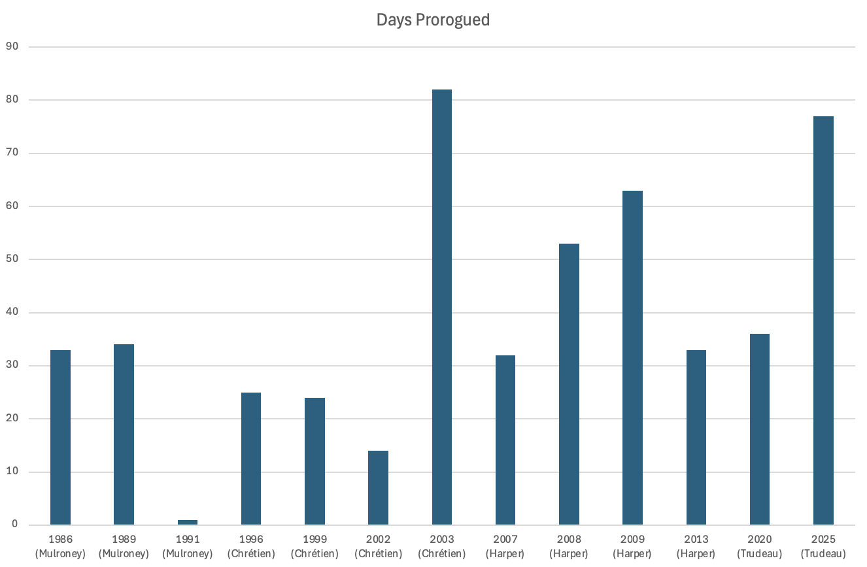
# of Days Prorogued, 1986-2025
Average 39 days (54 since 2003)
Trudeau’s 77: doesn’t include 20 days Parliament was adjourned
https://thehub.ca/2024/12/02/dave-snow-will-justin-trudeau-prorogue-parliament-in-the-new-year-history-shows-theres-little-political-cost-to-the-practice/
Notes:
This was a uniquely long prorogation
2003: Also coincided with Paul Martin becoming new PM, but the leadership race had already happened pre-prorogation

Slide 5
Controversial Prorogations
Chrétien 2003: Upcoming AG report on sponsorship
Harper 2008: Coalition crisis
Looming non-confidence vote
Harper 2009: Afghan Detainees committee, appointment of Senators
Harper 2013: Senate expense scandal
Trudeau 2020: WE Charity committee investigation
Trudeau 2025: Liberal leadership change
Looming non-confidence vote
Notes:
For example, while there was partisan criticism of Chrétien’s prorogation in 2003—with then Canadian Alliance leader Harper calling it a decision to “get out of town just one step ahead of the sheriff” to avoid fallout over an upcoming auditors’ general report—it received minimal media attention.
In all four prorogations since 2008, Prime Ministers Harper and Trudeau were forced to respond to criticisms that prorogation was designed to avoid a negative political outcome:
a non-confidence vote (2008),
committee revelations about Afghan detainees (2009),
questions regarding the Senate expense scandal (2013),
committee hearings regarding the WE Charity scandal (2020).
2008 and 2025: Looming but different non-confidence votes

Slide 6
Justifying Prorogations
Harper (2009, 2013) and Trudeau (2021) used similar justifications:
Technical: recalibrate, refresh, reset agenda
Policy-driven: Focus on the economy
Harper 2008: Conceded it was about stopping coalition
Trudeau 2025: Conceded it was to allow time for a leadership race
Unprecedented change in 2025: Federal Court agrees to hear legal challenge
Notes:
Looming but different non-confidence votes
For example, while there was partisan criticism of Chrétien’s prorogation in 2003—with then Canadian Alliance leader Harper calling it a decision to “get out of town just one step ahead of the sheriff” to avoid fallout over an upcoming auditors’ general report—it received minimal media attention.

